Slide 1




Dynamic Visualization Dashboard of
City of Los Angeles Sanitation Data
Jon Alvarado, Alexander Chan, Min Woo Sun
Joseph Gorelik, Conor McNamara
STATISTICS

Slide 2

Agenda
• Introduction
• Dashboard Demonstration
• Dashboard Architecture
• Acknowledgements

Slide 3




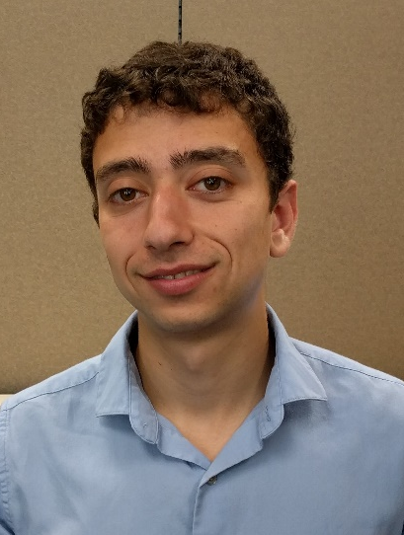

Introduction
Jon Alvarado
Alexander Chan
Min Woo Sun
Joseph Gorelik
Conor McNamara

Slide 4
Agenda
• Introduction
• Dashboard Demonstration
• Dashboard Architecture
• Acknowledgements
Notes:
Demonstrate Dashboard on Shiny

Slide 5
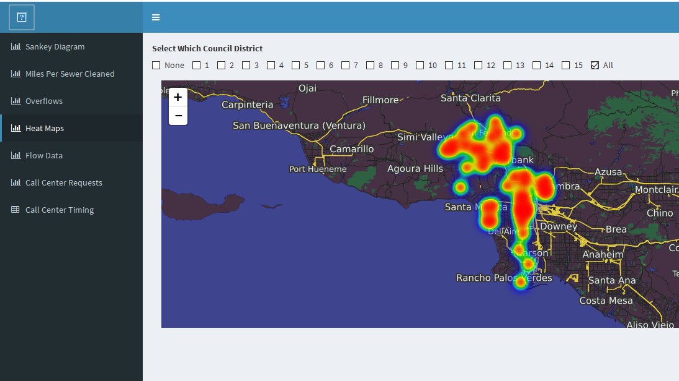
Time to Solve 311 Request Heat Maps
Red indicates longer time to solve a 311 request

Slide 6
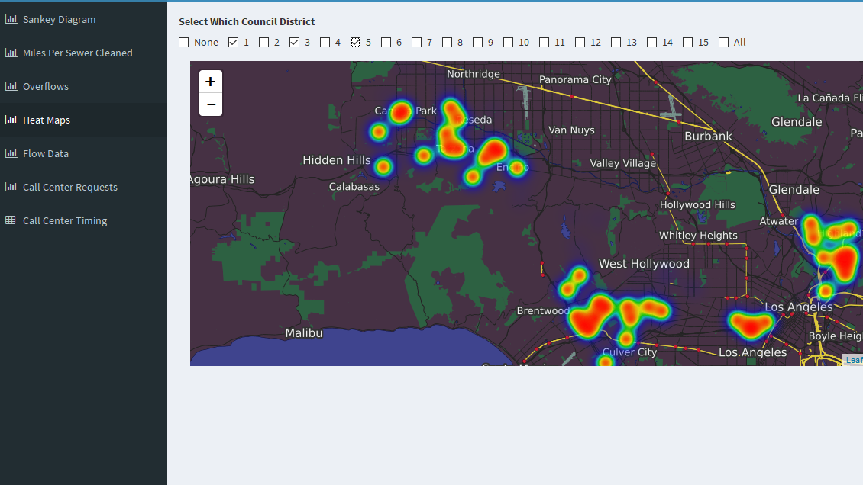
Heat Maps – Council Districts 1, 3, and 5

Slide 7
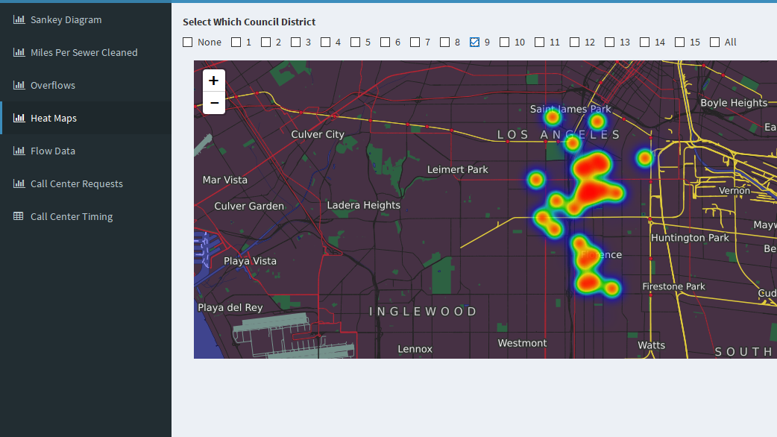
Heat Maps – Council District 9

Slide 8
Agenda
• Introduction
• Dashboard Demonstration
• Dashboard Architecture
• Acknowledgements

Slide 9




Dashboard Architecture
Visualization Packages
Data
311 Call Data
Clean Streets Score
Sewer Overflows
Miles of Sewer Cleaned
Flow Data
Dashboard
RSocrata
Near-Complete Dashboard Updates

Slide 10
Agenda
• Introduction
• Dashboard Demonstration
• Dashboard Architecture
• Acknowledgements

Slide 11

Acknowledgements
Dr. Vivian Lew
UCLA
Department of Statistics
Faculty Advisor
Hunter Owens
City of Los Angeles
Bureau of Sanitation
Client Liaison
Elyse Azevedo
City of Los Angeles
Bureau of Sanitation
Client Liaison

